Slide 1





Automatic Infrared-Based Volume and Mass Estimation System for Agricultural Products Along with Major Geometrical Properties
11th International Conference on Computer and Knowledge Engineering (ICCKE 2021), October 28-29, 2021, Ferdowsi University of Mashhad
Seyed Muhammad Hossein Mousavi S. Muhammad Hassan Mosavi Tehran, Iran

Slide 2

Goals:
11th International Conference on Computer and Knowledge Engineering (ICCKE 2021)
Decreases human error and saves more time
Using color and depth image (Kinect V.2)
In irregular and non-symmetrical shaped fruits
In different distance from sensor
Extracting 10 color and depth image features
Fast response in real time calculation
Automatic Infrared-Based Volume and Mass Estimation System for Agricultural Products
2

Slide 3
Introduction
11th International Conference on Computer and Knowledge Engineering (ICCKE 2021)
Better health care leads to more population.
More population means more source of food.
As demand increases, it lifts up the supply.
Modern tools to plant, harvest, quality evaluation and packaging are required.
In quality evaluation part, product grading plays an important role in quality management.
Volume and mass estimation are part of product grading process.
Automatic Infrared-Based Volume and Mass Estimation System for Agricultural Products
3

Slide 4
Introduction (Traditional Methods)
11th International Conference on Computer and Knowledge Engineering (ICCKE 2021)
Traditional volume estimation method is Water Displacement method (WD).
So time consuming and damages the products.
Does not calculate exact amount of volume in agricultural products in different shapes (irregular and non-symmetrical).
Higher final error.
Traditional mass estimation method is called Digital Balance (DB) method.
Time consuming and effects the freshness of the product.
To fix could use heavy machinery.
But it is so costly and required more space.
Automatic Infrared-Based Volume and Mass Estimation System for Agricultural Products
4

Slide 5
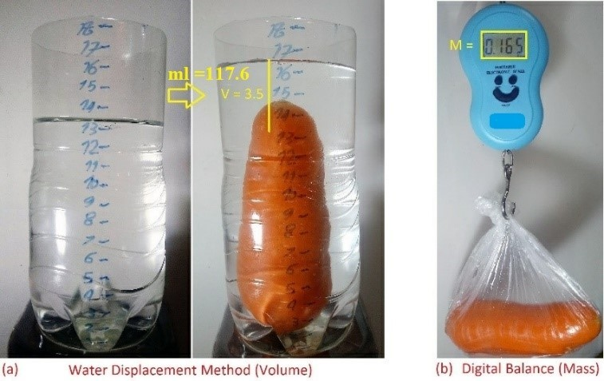
Introduction (Traditional Methods)
11th International Conference on Computer and Knowledge Engineering (ICCKE 2021)
(a) using traditional WD method on a carrot sample (volume) and (b) using traditional digital balance method for the same carrot (mass)
Automatic Infrared-Based Volume and Mass Estimation System for Agricultural Products
5

Slide 6
Introduction (Novel Methods)
11th International Conference on Computer and Knowledge Engineering (ICCKE 2021)
Computer vision techniques had impact in agricultural product processes.
One of the best impacts is in grading process like volume and mass estimation.
There are decent color image-based techniques in order to do that.
But with some issues.
Proposed method lifts up the existing methods to a level higher.
Improve in precision, different distances and also in pure darkness aspects.
Automatic Infrared-Based Volume and Mass Estimation System for Agricultural Products
6

Slide 7
Introduction (Kinect V.2)
11th International Conference on Computer and Knowledge Engineering (ICCKE 2021)
Kinect is one of the most famous depth sensors.
It is low-cost and available out there.
Employs night vision technology.
Works based on infrared particles in decent quality and resolution.
Is proper for both research purposes and in application.
Main tools for this research is Kinect V.2 sensor.
Automatic Infrared-Based Volume and Mass Estimation System for Agricultural Products
7

Slide 8
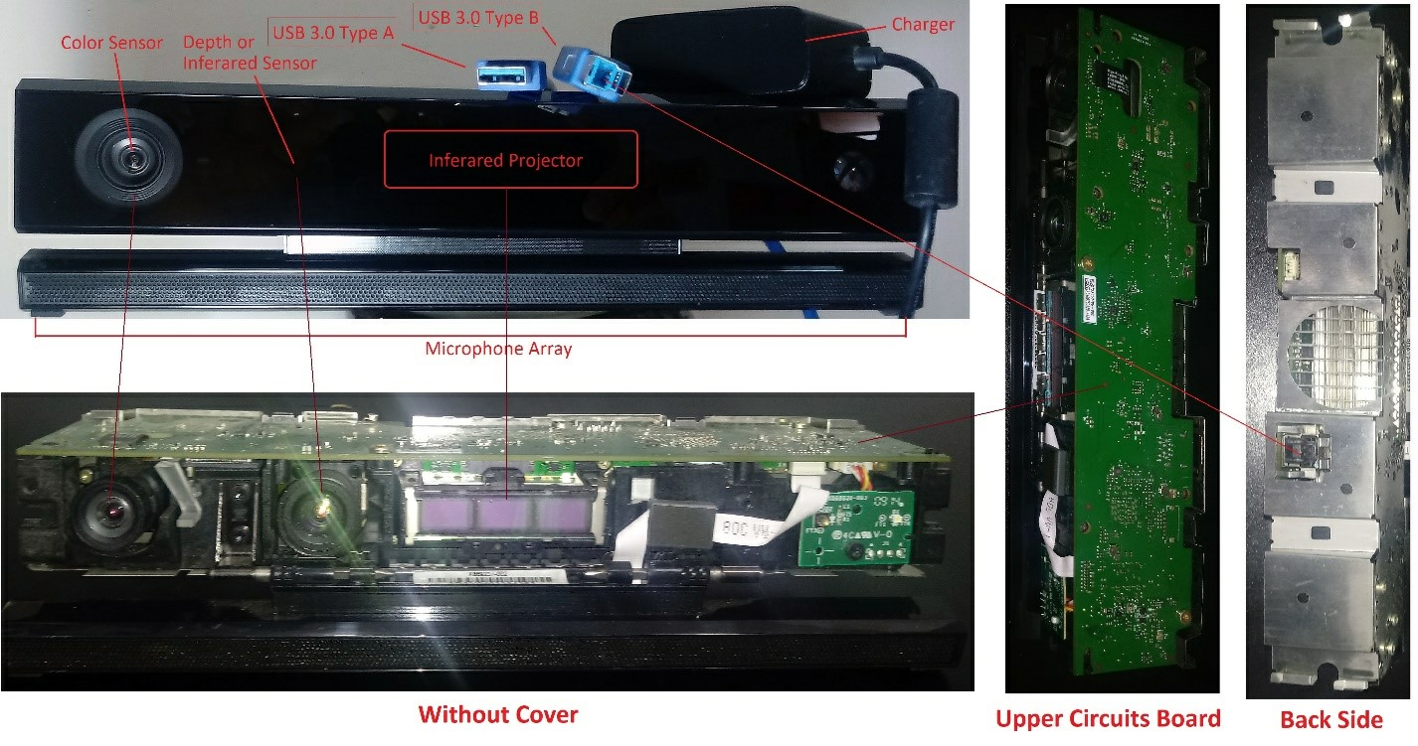
Introduction (Kinect V.2)
11th International Conference on Computer and Knowledge Engineering (ICCKE 2021)
Employed Kinect V.2 sensor in the research
Automatic Infrared-Based Volume and Mass Estimation System for Agricultural Products
8

Slide 9
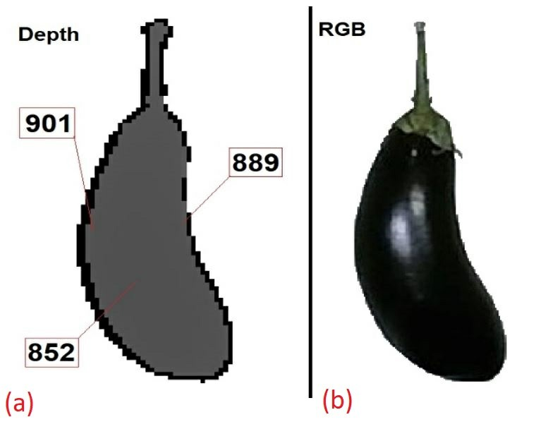
Introduction (Kinect V.2)
11th International Conference on Computer and Knowledge Engineering (ICCKE 2021)
(a) is the depth structure shown as an intensity channel of an eggplant vegetable.
The smaller value means closer distance to the sensor and vice versa.
(b) is the standard color (RGB) image of the same eggplant.
Depth image calls 2.5-Dimentional image.
It is possible to convert 2.5-D image into a 3-D image by a simple processing.
Automatic Infrared-Based Volume and Mass Estimation System for Agricultural Products
9

Slide 10
Prior Related Researches
11th International Conference on Computer and Knowledge Engineering (ICCKE 2021)
Jana, Susovan and et al (2020)
Automatic volume and mass estimation of fruits and vegetables.
Using ordinary smartphone color cameras.
System works for irregular and non-axisymmetric products.
Specific distance from sensor.
Potato, tomato and citrus products with 77 samples in total.
Their system did not support pure darkness situation and also in different distances.
Automatic Infrared-Based Volume and Mass Estimation System for Agricultural Products
10

Slide 11
Prior Related Researches
11th International Conference on Computer and Knowledge Engineering (ICCKE 2021)
Vivek Venkatesh, G. et al (2015)
Volume and mass of Axis-Symmetric fruits using color sensors (single view).
They extract the boundary counter.
Then categorized the fruit into circular and elliptical shapes.
Volume is calculated based on the specific fruit in each experiment.
Mass is calculated based on the relationship between mass and volume.
Four types of citruses in validation section (120 samples).
Their system does not support irregular and non-symmetrical shaped products.
Automatic Infrared-Based Volume and Mass Estimation System for Agricultural Products
11

Slide 12
Prior Related Researches
11th International Conference on Computer and Knowledge Engineering (ICCKE 2021)
Mousavi, S.M.H. and Prasath (2019)
Employed Depth sensors (Kinect).
Different product distances of 0.8, 1.0, and 1.3 meters from sensor.
System starts with pre-processing steps.
Estimating the weight using average weight of the experimented product and its distance From sensor plus a constant.
Finally normalization of the final value into gram.
150 samples of Sweet Lemons Sweet Peppers and Tomatoes for validation purposes.
Just estimate fruits weight.
Automatic Infrared-Based Volume and Mass Estimation System for Agricultural Products
12

Slide 13
Proposed Method
11th International Conference on Computer and Knowledge Engineering (ICCKE 2021)
A robust infrared based volume and mass estimation system.
Fruits and vegetables.
Fixes Some issues in available new and traditional methods.
Works on irregular and non-symmetrical shaped fruits.
In different distance from sensor.
Fast response in real time calculation.
Automatic Infrared-Based Volume and Mass Estimation System for Agricultural Products
13

Slide 14
Proposed Method (Pre-processing)
11th International Conference on Computer and Knowledge Engineering (ICCKE 2021)
Median filter followed by unsharp mask filter color and depth images.
Helps for smoothing from inside and sharpening from outside.
Canny edge detection filter on color and depth images.
Filling unnecessary holes using closing morphology operation.
Active contour segmentation
Extracting region boundaries
Background extraction
Automatic Infrared-Based Volume and Mass Estimation System for Agricultural Products
14

Slide 15
Proposed Method (Feature extraction)
11th International Conference on Computer and Knowledge Engineering (ICCKE 2021)
Ten 2-D and 3-D features are extracted from color and depth data.
Color data features are:
Length
Width
Diameter
Perimeter
Depth data features are:
Thickness or height
Surface area
Volume
Convex volume
Solidity
Mass
Automatic Infrared-Based Volume and Mass Estimation System for Agricultural Products
15

Slide 16
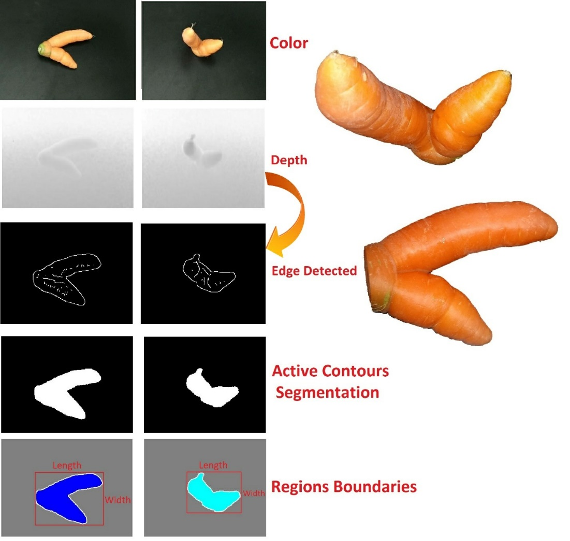
Proposed Method (Feature extraction)
11th International Conference on Computer and Knowledge Engineering (ICCKE 2021)
Some steps of preprocessing on one of the color sample from proposed database (2-D)
Automatic Infrared-Based Volume and Mass Estimation System for Agricultural Products
16

Slide 17
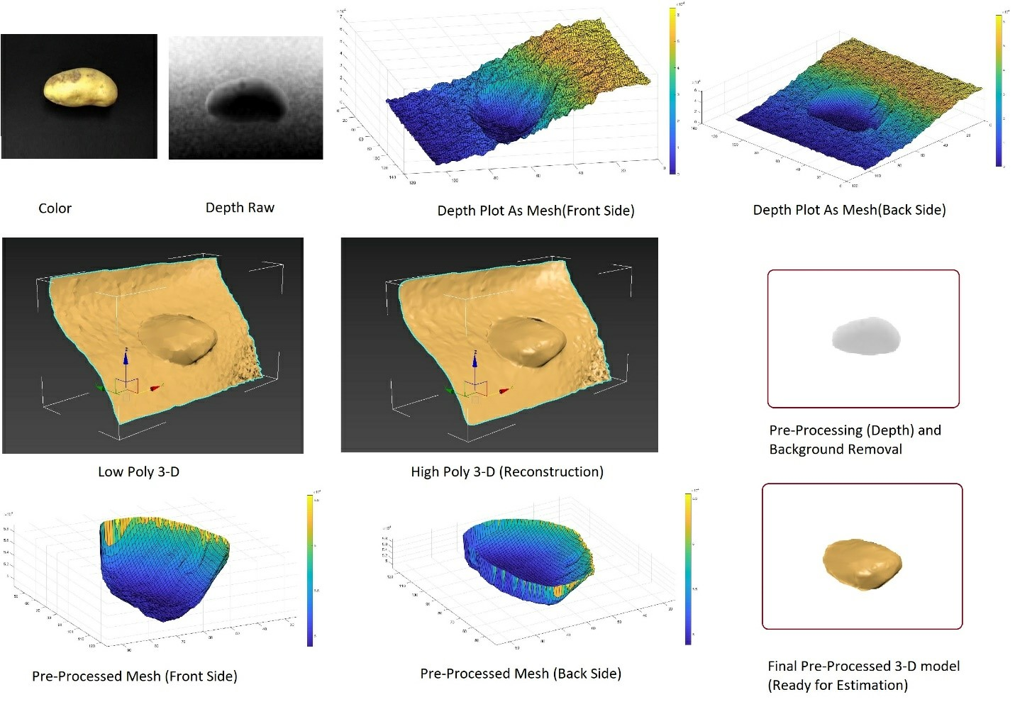
Proposed Method (Feature extraction)
11th International Conference on Computer and Knowledge Engineering (ICCKE 2021)
Some steps of preprocessing on one of the depth sample from proposed database (3-D)
Automatic Infrared-Based Volume and Mass Estimation System for Agricultural Products
17

Slide 18
Proposed Method (Feature extraction)
11th International Conference on Computer and Knowledge Engineering (ICCKE 2021)
Color data is used to extract 2-D features.
2-D Length, width
Length and width features are axis-pixel count based.
2-D Diameter
Fruits are non-symmetrical and carrot is not circular among other circular ones
So, diameter has different meaning here.
Diameter calculations two biggest axis-pixel value more than zero.
Finally, a straight line in centimeter determines the diameter value.
Automatic Infrared-Based Volume and Mass Estimation System for Agricultural Products
18

Slide 19
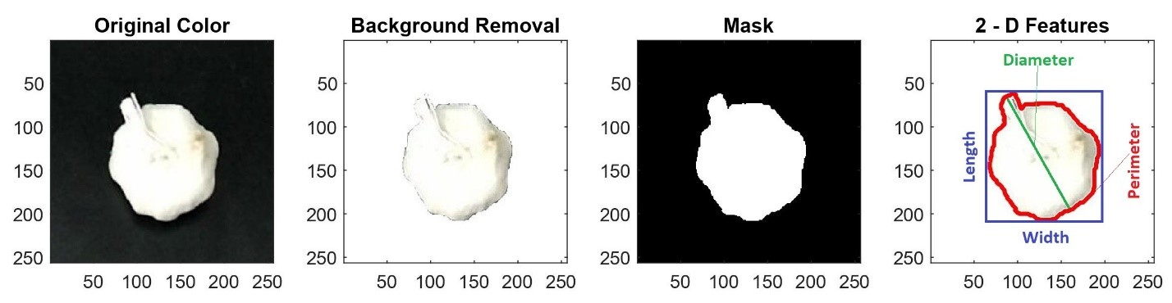
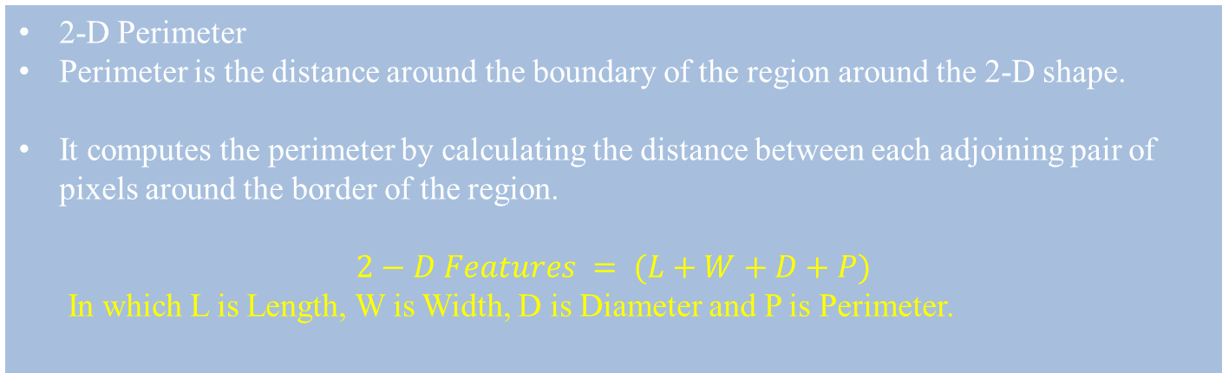
Proposed Method (Feature extraction)
11th International Conference on Computer and Knowledge Engineering (ICCKE 2021)
2-D Perimeter
Perimeter is the distance around the boundary of the region around the 2-D shape.
It computes the perimeter by calculating the distance between each adjoining pair of pixels around the border of the region.
$$2−D Features = (L+W+D+P)$$
In which L is Length, W is Width, D is Diameter and P is Perimeter.
Automatic Infrared-Based Volume and Mass Estimation System for Agricultural Products
19

Slide 20
Proposed Method (Feature extraction)
11th International Conference on Computer and Knowledge Engineering (ICCKE 2021)
3-D Thickness or height
Depth sensor calculates the distance between the sensor and the product.
Might some bumps be on the surface of the sample.
Thickness is highest gray level achieved from the top surface of the sample in depth data.
Data is recording from two sides and each side gives slightly different value of thickness.
The largest amount of two will be selected.
Automatic Infrared-Based Volume and Mass Estimation System for Agricultural Products
20

Slide 21
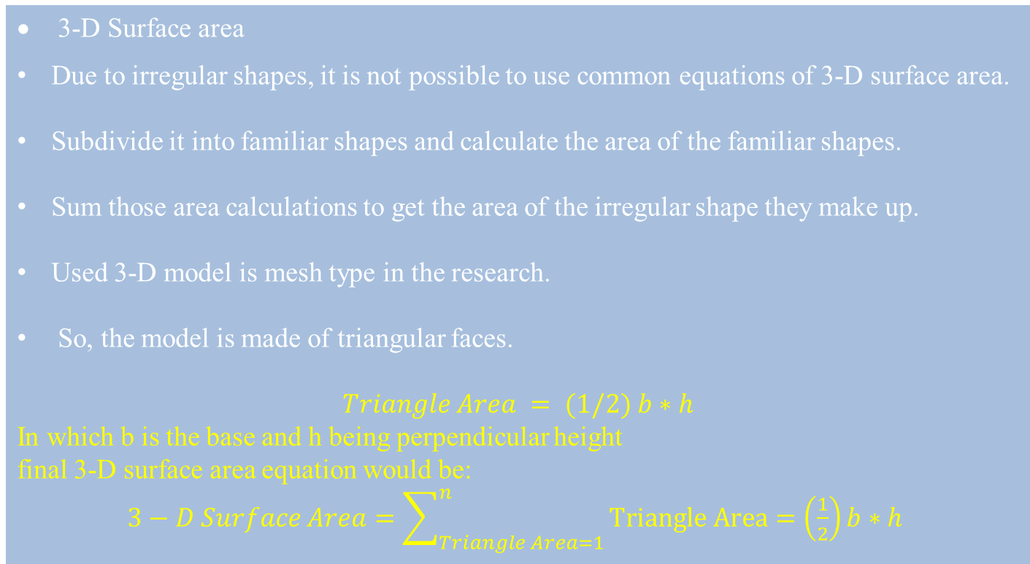
Proposed Method (Feature extraction)
11th International Conference on Computer and Knowledge Engineering (ICCKE 2021)
3-D Surface area
Due to irregular shapes, it is not possible to use common equations of 3-D surface area.
Subdivide it into familiar shapes and calculate the area of the familiar shapes.
Sum those area calculations to get the area of the irregular shape they make up.
Used 3-D model is mesh type in the research.
So, the model is made of triangular faces.
$$Triangle Area = (1/2) b∗h$$
In which b is the base and h being perpendicular height
final 3-D surface area equation would be:
$3−D Surface Area=\sum_{Triangle Area=1}^{n}{Triangle Area=\left(\frac{1}{2}\right)b∗h }$
Automatic Infrared-Based Volume and Mass Estimation System for Agricultural Products
21

Slide 22
Proposed Method (Feature extraction)
11th International Conference on Computer and Knowledge Engineering (ICCKE 2021)
3-D Convex volume and Solidity
Given a set of points in the plane, the convex hull of the set is the smallest convex polygon that contains all points of it.
Now, the convex volume is the volume of the convex hull, which its mesh structure is based on triangular calculations.
A voxel is a raster graphic on a 3-D grid, with the values of length, width and depth.
Proportion of the voxels in the convex hull that are also in the region, returned as a scalar which is computed as volume / convex volume is called Solidity.
Automatic Infrared-Based Volume and Mass Estimation System for Agricultural Products
22

Slide 23
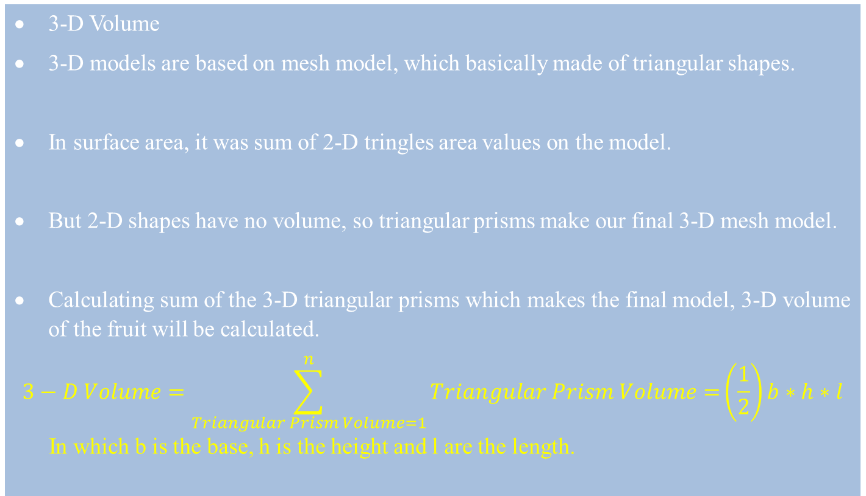
Proposed Method (Feature extraction)
11th International Conference on Computer and Knowledge Engineering (ICCKE 2021)
3-D Volume
3-D models are based on mesh model, which basically made of triangular shapes.
In surface area, it was sum of 2-D tringles area values on the model.
But 2-D shapes have no volume, so triangular prisms make our final 3-D mesh model.
Calculating sum of the 3-D triangular prisms which makes the final model, 3-D volume of the fruit will be calculated.
$$3−D Volume=\sum_{Triangular Prism Volume=1}^{n}{Triangular Prism Volume=}\left(\frac{1}{2}\right)b∗h∗l$$
In which b is the base, h is the height and l are the length.
Automatic Infrared-Based Volume and Mass Estimation System for Agricultural Products
23

Slide 24
Proposed Method (Feature extraction)
11th International Conference on Computer and Knowledge Engineering (ICCKE 2021)
3-D Mass
There is a relation between volume, mass and density.
Having two of them, another one is calculable.
Each matter has its unique density, which agricultural products are not exception.
Garlic has average density of 0.47 g/cm³, carrot’s density is 1.40 g/cm³, potato’s density is 0.63 g/cm³ and quince’s density is 0.91 g/cm^{3.}
The gram per cubic centimeter (g/cm³) is a unit of density defined as mass in grams divided by volume in cubic centimeters.
Automatic Infrared-Based Volume and Mass Estimation System for Agricultural Products
24

Slide 25
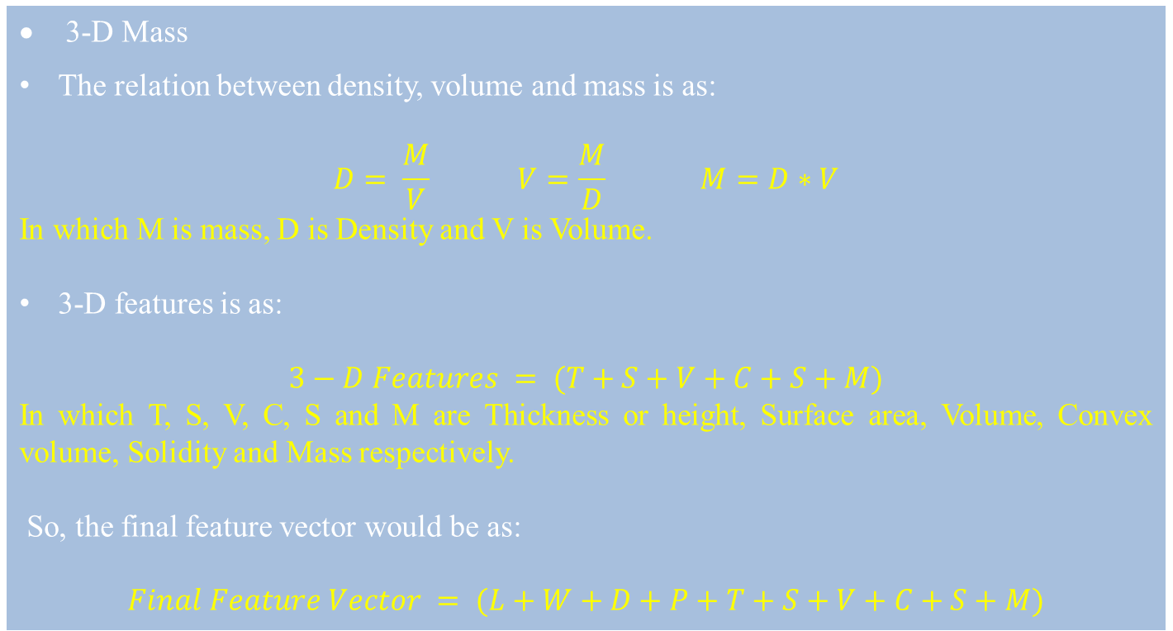
Proposed Method (Feature extraction)
11th International Conference on Computer and Knowledge Engineering (ICCKE 2021)
3-D Mass
The relation between density, volume and mass is as:
$$D= \frac{M}{V} V=\frac{M}{D} M=D∗V$$
In which M is mass, D is Density and V is Volume.
3-D features is as:
$$3−D Features = (T+S+V+C+S+M)$$
In which T, S, V, C, S and M are Thickness or height, Surface area, Volume, Convex volume, Solidity and Mass respectively.
So, the final feature vector would be as:
$Final Feature Vector = (L+W+D+P+T+S+V+C+S+M)$
Automatic Infrared-Based Volume and Mass Estimation System for Agricultural Products
25

Slide 26
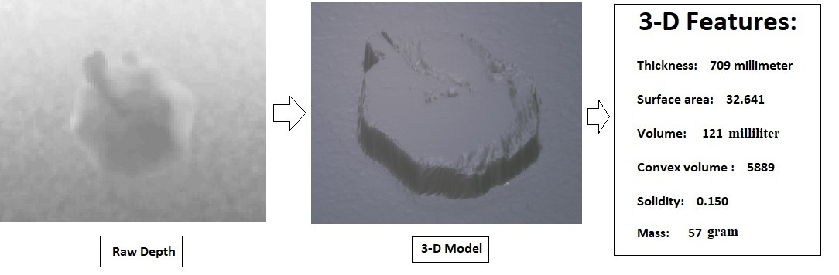
Proposed Method (Feature extraction)
11th International Conference on Computer and Knowledge Engineering (ICCKE 2021)
3-D features on one of the samples in the experiment
Automatic Infrared-Based Volume and Mass Estimation System for Agricultural Products
26

Slide 27
Proposed Dataset
11th International Conference on Computer and Knowledge Engineering (ICCKE 2021)
Total 60 samples in different shapes.
Axisymmetric, non-axisymmetric, regular shaped and non-regular shaped.
20 Potatoes, 15 Garlics, 15 Carrots and 10 Quinces.
Three Every Day Carry (EDC) LED Bulb 9 w power lights.
Kinect sensor is placed in 0.8-meter from subject (Distance is adjustable).
Windows 10 64-bit operating system along with MATLAB R 2019 b software.
Automatic Infrared-Based Volume and Mass Estimation System for Agricultural Products
27

Slide 28
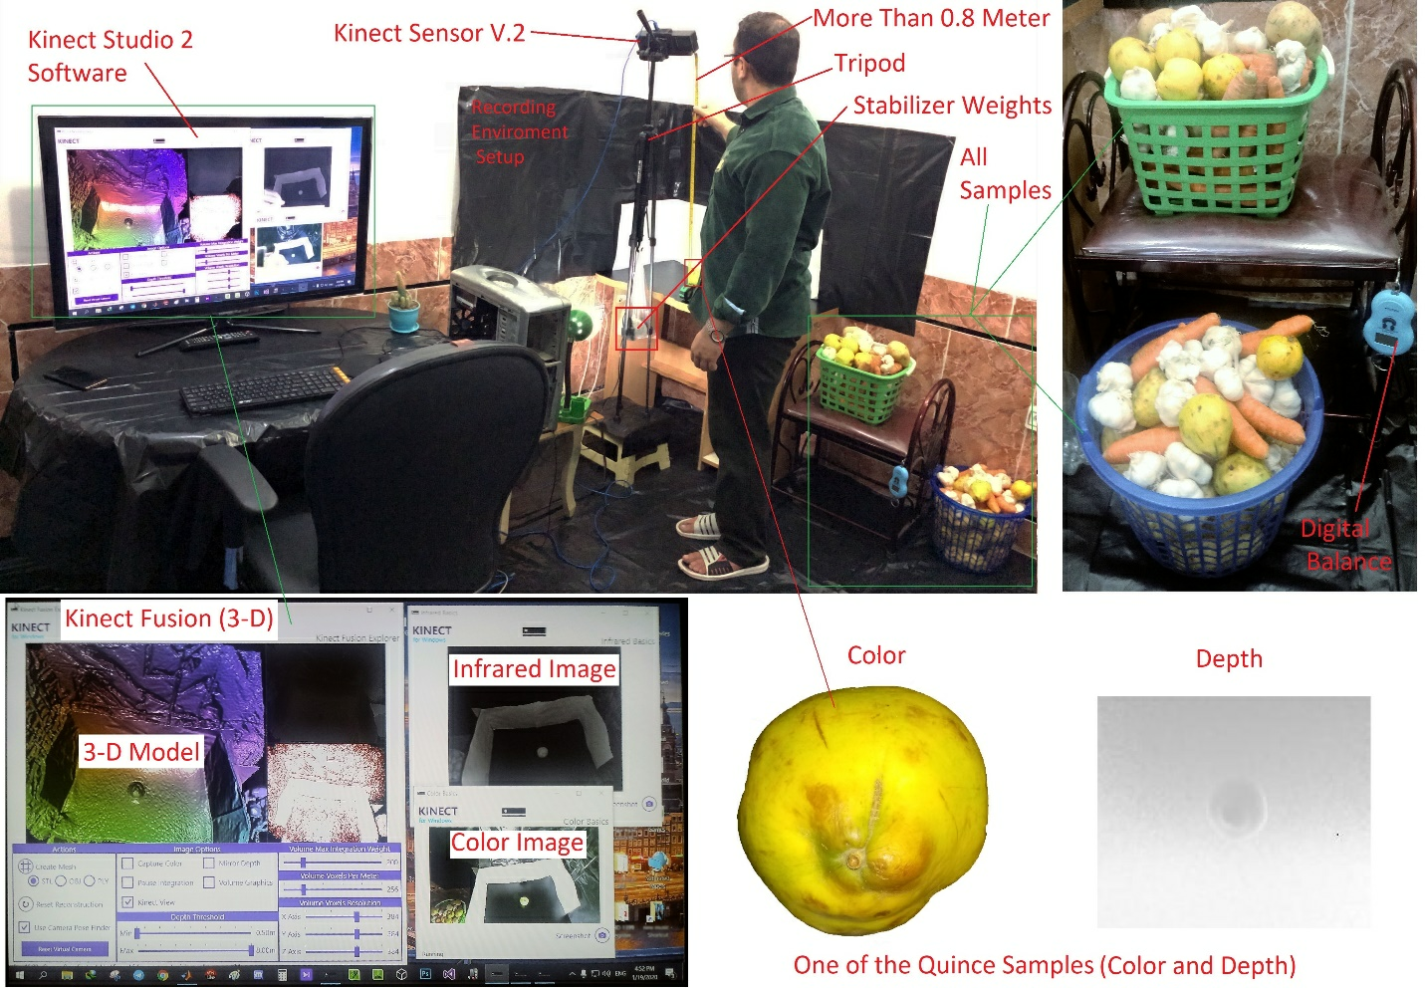
Proposed Dataset
11th International Conference on Computer and Knowledge Engineering (ICCKE 2021)
Recording setup environment
Automatic Infrared-Based Volume and Mass Estimation System for Agricultural Products
28

Slide 29
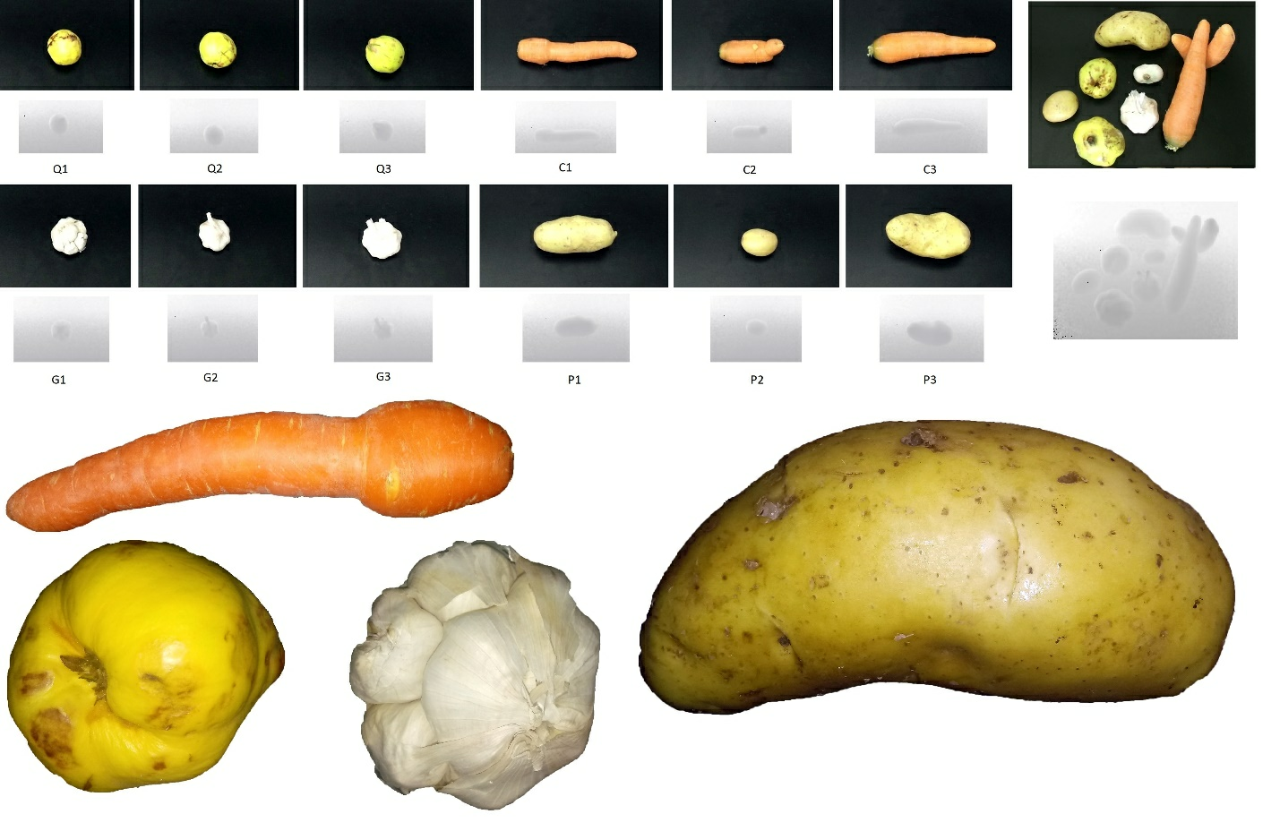
Proposed Dataset
11th International Conference on Computer and Knowledge Engineering (ICCKE 2021)
Some samples from proposed dataset
Automatic Infrared-Based Volume and Mass Estimation System for Agricultural Products
29

Slide 30
Validation and Results
11th International Conference on Computer and Knowledge Engineering (ICCKE 2021)
Comparison with proposed, traditional and modern volume and mass estimation.
Error metrics are Mean absolute error (MAE)
It’s the average over the test sample of the absolute differences between prediction and actual observation where all individual differences have equal weight.
Mean Absolute Percentage Error (MAPE)
Statistical measure of how accurate a predict system is.
The average absolute percent error for each time period minus actual values divided by actual values
Automatic Infrared-Based Volume and Mass Estimation System for Agricultural Products
30

Slide 31
Validation and Results
11th International Conference on Computer and Knowledge Engineering (ICCKE 2021)
Linear regression
Attempts to model the relationship between two variables.
One variable is considered to be an explanatory variable.
Other is considered to be a dependent variable.
Automatic Infrared-Based Volume and Mass Estimation System for Agricultural Products
31

Slide 32
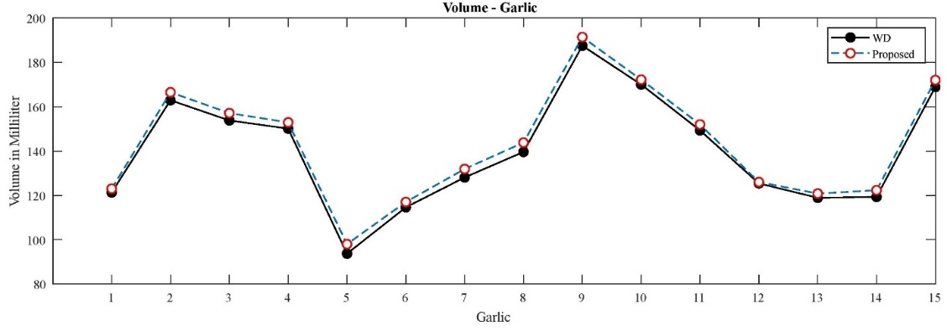
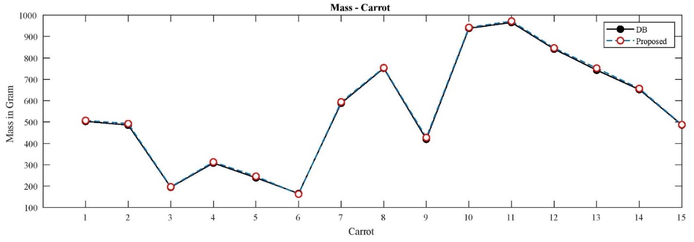
Validation and Results
11th International Conference on Computer and Knowledge Engineering (ICCKE 2021)
Comparison results for proposed volume estimation method versus WD method for garlic samples in milliliter
Comparison results for proposed mass estimation method versus DB method for carrot samples in gram
Automatic Infrared-Based Volume and Mass Estimation System for Agricultural Products
32

Slide 33
Validation and Results
11th International Conference on Computer and Knowledge Engineering (ICCKE 2021)
Sample | Volume (ml) – (D = 0.63 g/cm³) |  |  |  |  | Mass (gm) |  |  |  |  | Run time (sec)
Potato | WD | [10] | [2] | [11] | Proposed | DB | [10] | [2] | [11] | Proposed | Proposed
P01 | 462.0 | 453.6 | 447.0 | 474.8 | 466.1 | 291.06 | 285.76 | 281.61 | 299.12 | 293.64 | 0.61
P02 | 317.1 | 308.7 | 302.1 | 329.9 | 318.3 | 199.77 | 194.48 | 190.32 | 207.83 | 200.52 | 0.69
P03 | 252.0 | 243.6 | 237.0 | 264.8 | 256.3 | 158.76 | 153.46 | 149.31 | 166.82 | 161.46 | 0.65
P04 | 342.3 | 333.9 | 327.3 | 355.1 | 347.9 | 215.64 | 210.35 | 206.19 | 223.71 | 219.17 | 0.51
P05 | 333.9 | 325.5 | 318.9 | 346.7 | 340.6 | 210.35 | 205.06 | 200.90 | 218.42 | 214.57 | 0.58
P06 | 212.1 | 203.7 | 197.1 | 224.9 | 218.7 | 133.62 | 128.33 | 124.17 | 141.68 | 137.78 | 0.61
P07 | 602.7 | 594.3 | 587.7 | 615.5 | 608.8 | 379.70 | 374.40 | 370.25 | 387.76 | 383.54 | 0.59
P08 | 632.1 | 623.7 | 617.1 | 644.9 | 635.6 | 398.22 | 392.93 | 388.77 | 406.28 | 400.42 | 0.49
P09 | 651.0 | 642.6 | 636.0 | 663.8 | 653.3 | 410.13 | 404.83 | 400.68 | 418.19 | 411.57 | 0.56
P10 | 854.7 | 846.3 | 839.7 | 867.2 | 856.3 | 538.46 | 533.16 | 529.01 | 546.33 | 539.46 | 0.71
P11 | 235.2 | 226.8 | 220.2 | 248.2 | 236.4 | 148.17 | 142.88 | 138.72 | 156.36 | 148.93 | 0.77
P12 | 300.3 | 291.9 | 285.3 | 313.1 | 302.8 | 189.18 | 183.89 | 179.73 | 197.25 | 190.76 | 0.69
P13 | 317.1 | 308.7 | 302.1 | 329.9 | 323.1 | 199.77 | 194.48 | 190.32 | 207.83 | 203.55 | 0.57
P14 | 585.9 | 577.5 | 570.9 | 598.7 | 592.2 | 369.11 | 363.82 | 359.66 | 377.18 | 373.08 | 0.58
P15 | 537.6 | 529.2 | 522.6 | 550.4 | 539.7 | 338.68 | 333.39 | 329.23 | 346.75 | 340.01 | 0.62
P16 | 392.7 | 384.3 | 377.7 | 405.5 | 400.8 | 247.40 | 242.10 | 237.95 | 255.45 | 252.50 | 0.68
P17 | 342.3 | 333.9 | 327.3 | 355.1 | 347.3 | 215.64 | 210.35 | 206.19 | 223.71 | 218.79 | 0.59
P18 | 535.5 | 527.1 | 520.5 | 548.3 | 538.4 | 337.36 | 332.07 | 327.91 | 345.42 | 339.19 | 0.78
P19 | 363.3 | 354.9 | 348.3 | 376.1 | 366.9 | 228.87 | 223.58 | 219.42 | 236.94 | 231.14 | 0.81
P20 | 758.1 | 749.7 | 743.1 | 770.9 | 759.7 | 477.60 | 472.31 | 468.15 | 485.66 | 478.61 | 0.56
Comparison results for potato samples
Automatic Infrared-Based Volume and Mass Estimation System for Agricultural Products
33

Slide 34
Validation and Results
11th International Conference on Computer and Knowledge Engineering (ICCKE 2021)
Sample | Volume (ml) – (D = 0.47 g/cm³) |  |  |  |  | Mass (gm) |  |  |  |  | Run time (sec)
Garlic | WD | [10] | [2] | [11] | Proposed | DB | [10] | [2] | [11] | Proposed | Proposed
G 01 | 121.3 | 113.6 | 112.1 | 127.1 | 123.0 | 57.01 | 53.39 | 52.69 | 59.74 | 57.81 | 0.51
G 02 | 162.9 | 155.2 | 153.7 | 168.7 | 166.5 | 76.56 | 72.94 | 72.24 | 79.29 | 78.26 | 0.69
G 03 | 153.8 | 146.1 | 144.6 | 159.6 | 157.1 | 72.29 | 68.67 | 67.96 | 75.01 | 73.84 | 0.48
G 04 | 150.1 | 142.4 | 140.9 | 155.9 | 152.9 | 70.55 | 66.93 | 66.22 | 73.27 | 71.86 | 0.53
G 05 | 93.7 | 86.0 | 84.50 | 99.50 | 98.0 | 44.04 | 40.42 | 39.71 | 46.77 | 46.06 | 0.52
G 06 | 114.6 | 106.9 | 105.4 | 120.4 | 117.0 | 53.86 | 50.24 | 49.54 | 56.59 | 54.99 | 0.56
G 07 | 128.1 | 120.4 | 118.9 | 133.9 | 131.9 | 60.21 | 56.59 | 55.88 | 62.93 | 61.99 | 0.57
G 08 | 139.6 | 131.9 | 130.4 | 145.4 | 143.8 | 65.61 | 61.99 | 61.29 | 68.34 | 67.59 | 0.41
G 09 | 187.5 | 179.8 | 178.3 | 193.3 | 191.4 | 88.13 | 84.51 | 83.80 | 90.85 | 89.96 | 0.69
G 10 | 170.0 | 162.3 | 160.8 | 175.8 | 172.2 | 79.90 | 76.28 | 75.58 | 82.63 | 80.93 | 0.71
G 11 | 149.3 | 141.6 | 140.1 | 155.1 | 152.0 | 70.17 | 66.55 | 65.85 | 72.90 | 71.44 | 0.69
G 12 | 125.4 | 117.7 | 116.2 | 131.2 | 126.0 | 58.94 | 55.32 | 54.61 | 61.66 | 59.22 | 0.62
G 13 | 118.9 | 111.2 | 109.7 | 124.7 | 120.8 | 55.88 | 52.26 | 51.56 | 58.61 | 56.78 | 0.61
G 14 | 119.3 | 111.6 | 110.1 | 125.1 | 122.3 | 56.07 | 52.45 | 51.75 | 58.80 | 57.48 | 0.58
G 15 | 168.9 | 161.2 | 159.7 | 174.7 | 172.0 | 79.38 | 75.76 | 75.06 | 82.11 | 80.84 | 0.59
Comparison results for garlic samples
Automatic Infrared-Based Volume and Mass Estimation System for Agricultural Products
34

Slide 35
Validation and Results
11th International Conference on Computer and Knowledge Engineering (ICCKE 2021)
Sample | Volume (ml) – (D = 1.4 g/cm³) |  |  |  |  | Mass (gm) |  |  |  |  | Run time (sec)
Carrot | WD | [10] | [2] | [11] | Proposed | DB | [10] | [2] | [11] | Proposed | Proposed
C 01 | 359.3 | 348.7 | 350.6 | 368.8 | 362.4 | 503.02 | 488.18 | 490.84 | 516.32 | 507.36 | 0.71
C 02 | 346.8 | 336.2 | 338.1 | 356.3 | 351.8 | 485.52 | 470.68 | 473.34 | 498.82 | 492.52 | 0.72
C 03 | 139.2 | 128.6 | 130.5 | 148.7 | 140.5 | 194.88 | 180.04 | 182.70 | 208.18 | 196.70 | 0.89
C 04 | 220.0 | 209.4 | 211.3 | 229.5 | 223.6 | 308.00 | 293.16 | 295.82 | 321.30 | 313.04 | 0.59
C 05 | 170.8 | 160.2 | 162.1 | 180.3 | 175.8 | 239.12 | 224.28 | 226.94 | 252.42 | 246.12 | 0.63
C 06 | 117.6 | 119.0 | 120.9 | 139.1 | 116.7 | 165.44 | 166.60 | 169.26 | 194.74 | 162.78 | 0.69
C 07 | 419.9 | 409.3 | 411.2 | 429.4 | 424.2 | 587.86 | 573.02 | 575.68 | 601.16 | 593.88 | 0.57
C 08 | 536.9 | 526.3 | 528.2 | 546.4 | 538.5 | 751.66 | 736.82 | 739.48 | 764.96 | 753.90 | 0.52
C 09 | 299.6 | 289.0 | 290.9 | 309.1 | 305.3 | 419.44 | 404.60 | 407.26 | 432.74 | 427.42 | 0.67
C 10 | 670.2 | 659.6 | 661.5 | 679.7 | 673.2 | 938.28 | 923.44 | 926.10 | 951.58 | 942.48 | 0.72
C 11 | 689.8 | 679.2 | 681.1 | 699.3 | 694.3 | 965.72 | 950.88 | 953.54 | 979.02 | 972.02 | 0.63
C 12 | 601.0 | 590.4 | 592.3 | 610.5 | 604.7 | 841.40 | 826.56 | 829.22 | 854.70 | 846.58 | 0.64
C 13 | 530.6 | 520.0 | 521.9 | 540.1 | 537.0 | 742.84 | 728.00 | 730.66 | 756.14 | 751.80 | 0.58
C 14 | 465.6 | 455.0 | 456.9 | 475.1 | 469.1 | 651.84 | 637.00 | 639.66 | 665.14 | 656.74 | 0.78
C 15 | 347.4 | 336.8 | 338.7 | 356.9 | 348.3 | 486.36 | 471.52 | 474.18 | 499.66 | 487.62 | 0.70
Comparison results for carrot samples
Automatic Infrared-Based Volume and Mass Estimation System for Agricultural Products
35

Slide 36
Validation and Results
11th International Conference on Computer and Knowledge Engineering (ICCKE 2021)
Sample | Volume (ml) – (D = 0.91 g/cm³) |  |  |  |  | Mass (gm) |  |  |  |  | Run time (sec)
Quince | WD | [10] | [2] | [11] | Proposed | DB | [10] | [2] | [11] | Proposed | Proposed
Q 01 | 329.5 | 322.3 | 320.9 | 337.4 | 331.5 | 299.85 | 293.29 | 292.02 | 307.03 | 301.67 | 0.64
Q 02 | 313.3 | 306.1 | 304.7 | 321.2 | 316.9 | 285.10 | 278.55 | 277.28 | 292.29 | 288.38 | 0.59
Q 03 | 269.9 | 262.7 | 261.3 | 277.8 | 271.6 | 245.61 | 239.06 | 237.78 | 252.80 | 247.16 | 0.53
Q 04 | 197.0 | 189.8 | 188.4 | 204.9 | 199.0 | 179.27 | 172.72 | 171.44 | 186.46 | 181.09 | 0.50
Q 05 | 286.3 | 279.1 | 277.7 | 294.2 | 288.2 | 260.53 | 253.98 | 252.71 | 267.72 | 262.26 | 0.56
Q 06 | 225.6 | 218.4 | 217.0 | 233.5 | 229.3 | 205.30 | 198.74 | 197.47 | 212.49 | 208.66 | 0.63
Q 07 | 203.9 | 196.7 | 195.3 | 211.8 | 206.2 | 185.55 | 179.00 | 177.72 | 192.74 | 187.64 | 0.76
Q 08 | 412.6 | 405.4 | 404.0 | 420.5 | 415.3 | 375.47 | 368.91 | 367.64 | 382.66 | 377.92 | 0.70
Q 09 | 568.9 | 561.7 | 560.3 | 576.8 | 571.7 | 517.70 | 511.15 | 509.87 | 524.89 | 520.25 | 0.68
Q 10 | 398.2 | 391.0 | 389.6 | 406.1 | 401.5 | 362.36 | 355.81 | 354.54 | 369.55 | 365.37 | 0.62
Comparison results for quince samples
Automatic Infrared-Based Volume and Mass Estimation System for Agricultural Products
36

Slide 37
Validation and Results
11th International Conference on Computer and Knowledge Engineering (ICCKE 2021)
 | Volume |  |  | Mass
 | MAE | MAPE |  | MAE | MAPE
Potato | [10] = 8.40 [2] = 15.00 [11] = 12.79 Proposed = 4.06 | [10] = 2.16 [2] = 3.86 [11] = 3.30 Proposed = 1.09 |  | [10] = 5.29 [2] = 9.45 [11] = 8.06 Proposed = 2.56 | [10] = 2.12 [2] = 3.88 [11] = 3.32 Proposed = 1.08
Garlic | [10] = 7.70 [2] = 9.20 [11] = 5.80 Proposed = 2.90 | [10] = 5.67 [2] = 6.77 [11] = 4.27 Proposed = 2.12 |  | [10] = 3.62 [2] = 4.32 [11] = 2.72 Proposed = 1.36 | [10] = 5.61 [2] = 6.75 [11] = 4.22 Proposed = 2.10
Carrot | [10] = 9.98 [2] = 8.34 [11] = 10.30 Proposed = 3.50 | [10] = 3.07 [2] = 2.64 [11] = 3.90 Proposed = 1.04 |  | [10] = 13.92 [2] = 11.62 [11] = 14.36 Proposed = 4.99 | [10] = 3.03 [2] = 2.61 [11] = 3.86 Proposed = 1.10
Quince | [10] = 7.20 [2] = 8.60 [11] = 7.90 Proposed = 2.60 | [10] = 2.48 [2] = 2.96 [11] = 2.72 Proposed = 0.88 |  | [10] = 6.55 [2] = 7.82 [11] = 7.18 Proposed = 2.36 | [10] = 2.48 [2] = 2.97 [11] = 2.72 Proposed = 0.89
Error results for all methods and all samples (volume and mass)
Automatic Infrared-Based Volume and Mass Estimation System for Agricultural Products
37

Slide 38
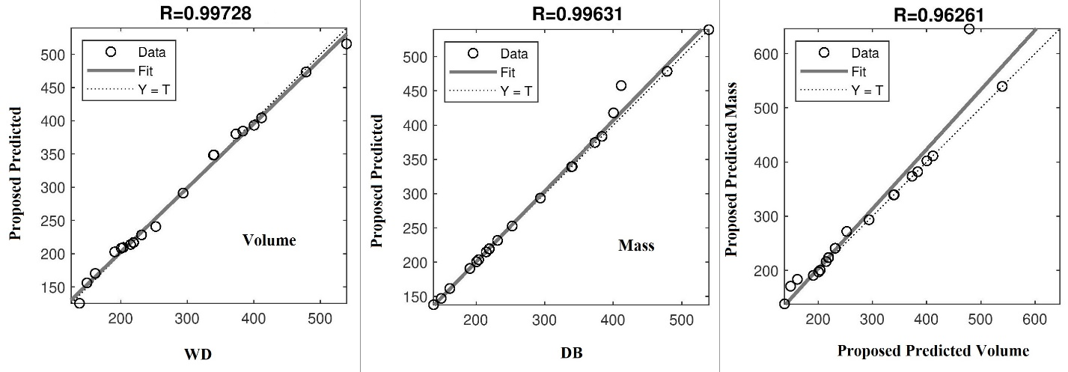
Validation and Results
11th International Conference on Computer and Knowledge Engineering (ICCKE 2021)
Linear regression for potato samples (Proposed vs WD (volume)- Proposed vs DB (mass)- Proposed vs Proposed (volume and mass))
Automatic Infrared-Based Volume and Mass Estimation System for Agricultural Products
38

Slide 39
Conclusion, discussion and suggestions for future works
11th International Conference on Computer and Knowledge Engineering (ICCKE 2021)
Adding depth data to color data, increases the final detection and recognition accuracy.
Kinect sensor is a suitable tool in agricultural product grading.
3-D features plus 2-D features fixes traditional and color-based methods weaknesses.
Single image based and non-learning based, so the runtime speed is high.
Cheap price, so rational to replace this digital system with traditional heavy machinery.
No product damage and no high error in big scales.
Suggested to use more fruits or vegetables with the system.
Suggested to use more than two angles on agricultural products.
Suggested to using more sensors for simultaneous recording.
Automatic Infrared-Based Volume and Mass Estimation System for Agricultural Products
39

Slide 40

References
11th International Conference on Computer and Knowledge Engineering (ICCKE 2021)
Sachdeva, Sandeep, Tilak R. Sachdev, and Ruchi Sachdeva. "Increasing fruit and vegetable consumption: challenges and opportunities." Indian journal of community medicine: official publication of Indian Association of Preventive & Social Medicine 38.4 (2013): 192.
Jana, Susovan, Ranjan Parekh, and Bijan Sarkar. "A De novo approach for automatic volume and mass estimation of fruits and vegetables." Optik 200 (2020): 163443.
Brosnan, Tadhg, and Da-Wen Sun. "Inspection and grading of agricultural and food products by computer vision systems—a review." Computers and electronics in agriculture 36.2-3 (2002): 193-213.
Gupta, Tushar, Mohan Yellishetty, and T. N. Singh. "Measurement of Bulk volume and Density of Irregular Solid Samples by Sand Displacement Method." Rock Mechanics and Rock Engineering 50.3 (2017): 639-645.
Saranya, N., et al. "Fruit Classification Using Traditional Machine Learning and Deep Learning Approach." International Conference On Computational Vision and Bio Inspired Computing. Springer, Cham, 2019.
Cornejo, Jadisha Yarif Ramírez, and Helio Pedrini. "Automatic fruit and vegetable recognition based on CENTRIST and color representation." Iberoamerican Congress on Pattern Recognition. Springer, Cham, 2016.
Mousavi, Seyed Muhammad Hossein, Vyacheslav Lyashenko, and Surya Prasath. "Analysis of a robust edge detection system in different color spaces using color and depth images." Компьютерная оптика 43.4 (2019).
Raheja, J. L., et al. "Robust gesture recognition using Kinect: A comparison between DTW and HMM." Optik 126.11-12 (2015): 1098-1104.
Mousavi, Seyed Muhammad Hossein, and S. Younes Mirinezhad. "Iranian kinect face database (IKFDB): a color-depth based face database collected by kinect v. 2 sensor." SN Applied Sciences 3.1 (2021): 1-17.
Vivek Venkatesh, G., et al. "Estimation of volume and mass of axi-symmetric fruits using image processing technique." International journal of food properties 18.3 (2015): 608-626.
Automatic Infrared-Based Volume and Mass Estimation System for Agricultural Products
40

Slide 41
References
11th International Conference on Computer and Knowledge Engineering (ICCKE 2021)
Liu, Sidong, et al. "Localized sparse code gradient in alzheimer's disease staging." 2013 35th Annual International Conference of the IEEE Engineering in Medicine and Biology Society (EMBC). IEEE, 2013.
Mesbah Oskui, Shirin, et al. "Measuring the mass, volume, and density of microgram-sized objects in fluid." PloS one 12.4 (2017): e0174068.
Maiseli, Baraka Jacob. "Optimum design of chamfer masks using symmetric mean absolute percentage error." EURASIP Journal on Image and Video Processing 2019.1 (2019): 74.
Ahmar, Ansari Saleh. "Sutte Indicator: an approach to predict the direction of stock market movements." arXiv preprint arXiv:1903.11642 (2019).
Bartlett, Peter L., et al. "Benign overfitting in linear regression." Proceedings of the National Academy of Sciences (2020).
Walker, M. L., et al. "An improved boxplot for univariate data." The American Statistician 72.4 (2018): 348-353.
Han, Hua, et al. "Least squares support vector machine (LS-SVM)-based chiller fault diagnosis using fault indicative features." Applied Thermal Engineering 154 (2019): 540-547.
Santiago Jr, Cereneo Sailog, et al. "Development and Evaluation of Portable Oil Density Scale Device." International Journal of Computing Sciences Research 3.3 (2019): 1-12.
Mousavi, Seyed Muhammad Hossein, Vincent Charles, and Tatiana Gherman. "An Evolutionary Pentagon Support Vector Finder Method." Expert Systems with Applications 150 (2020): 113284.
Mousavi, Seyed Muhammad Hossein, S. Younes MiriNezhad, and Atiye Mirmoini. "A new support vector finder method, based on triangular calculations and K-means clustering." 2017 9th International Conference on Information and Knowledge Technology (IKT). IEEE, 2017.
Automatic Infrared-Based Volume and Mass Estimation System for Agricultural Products
41

Slide 42
11th International Conference on Computer and Knowledge Engineering (ICCKE 2021)
Thank You so Much for Your Attention.
???
Automatic Infrared-Based Volume and Mass Estimation System for Agricultural Products

